Slide 1
Lalitha Priya Bhupalam
Mehdi Naderi Varandi
Yavor Edipov
James Craster
Oluwafemi Oladipo
Iurii Maksymets
Autistica Challenge
Team 21

Slide 2
Aim
Automate
Automate the resources and steps needed for a longitudinal study
Create
Create great user experience
Provide
Provide critical insights to researchers and employers

Slide 3
Difficult to Reach more people
Misdiagnoses can occur due to lack of understanding/studies done solely on men
Challenges for the Client

Slide 4
Live Tech Demo

Slide 5
Easily accessible by anyone, on any device
Simple and easy to use
Extremely customizable – suits any users needs
Provides immediate insight
Allows researcher/employer to customise and add new questions
Benefits and advantages of our solution

Slide 6
How do we meet the judging criteria?
Fit to NGO Challenge/Need | How well does the proposed solution respond to the NGO challenge statement? How creative is the solution? Is it doing more than just leveraging existing technologies?
Level of Innovation | How creative is the solution? Is it doing more than just leveraging existing technologies?
Quality of Pitch | How well did the particpants pitch their solution? How will did the participants respond to questions?
Completeness of Solution | Does the solution work? Was a roadmap completed and presented for unfinished items?
Sustainability/Feasibility | Is this a solution that the NGO can take and build on? Is the solution Frankenware (technologies mashed together for a short-term fix)? Is the solution financially sustainable? Can it realistically be executed?

Slide 7
Roadmap
In the future, we can:
Leverage NLP to provide insights about qualitative data
Most of the work on this is done already!

Slide 8
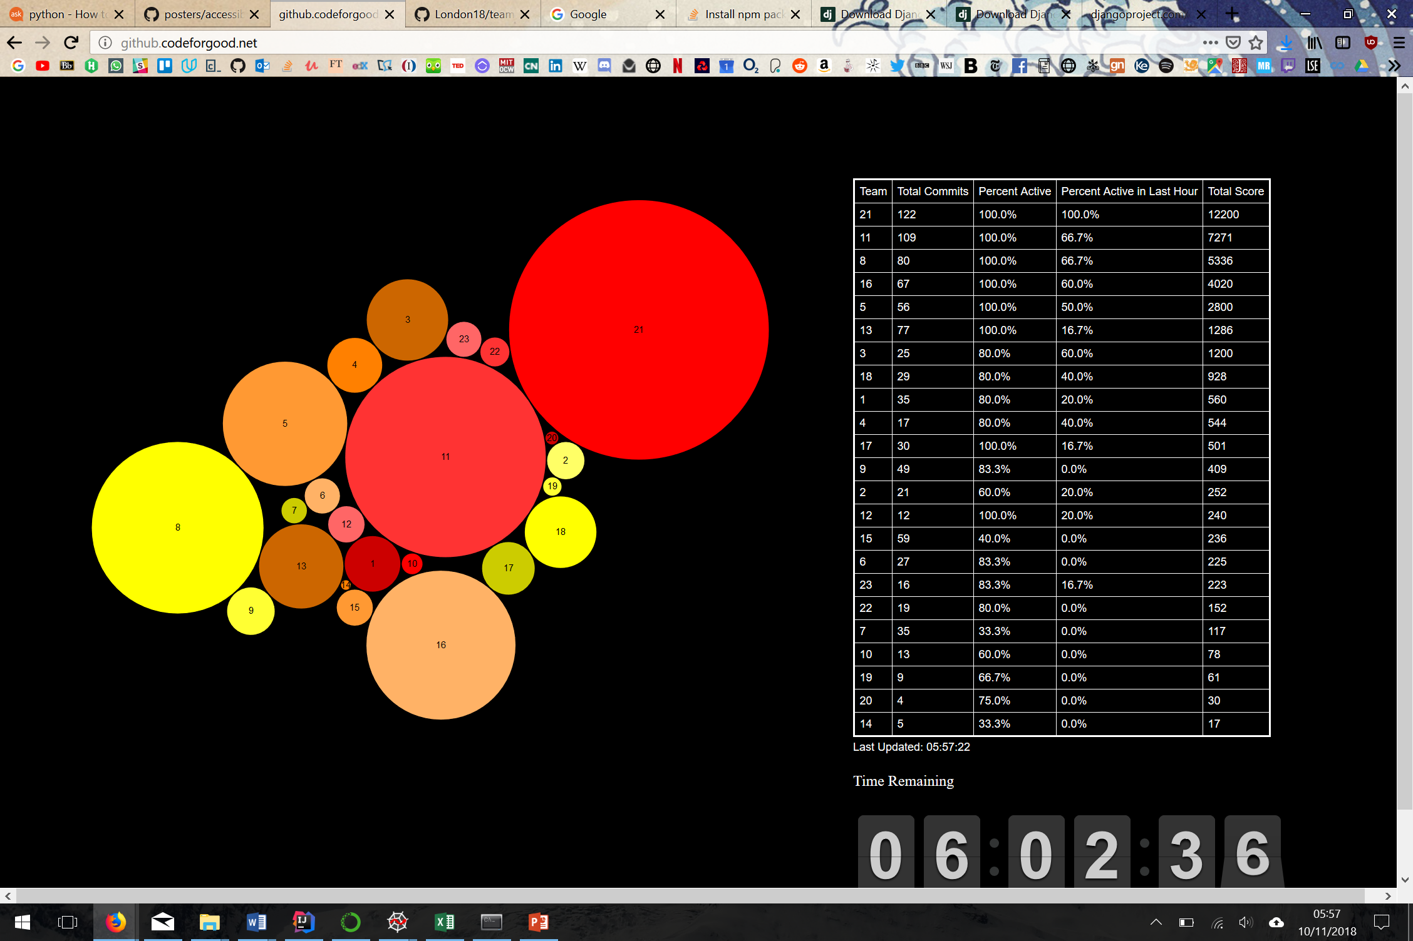
Our Accreditations and awards
21
21

